Slide 1

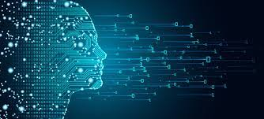
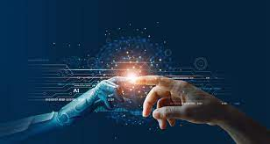
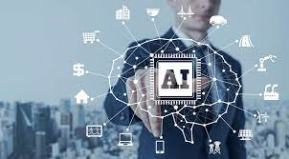
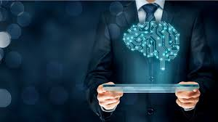
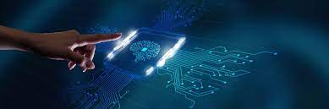
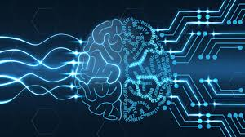
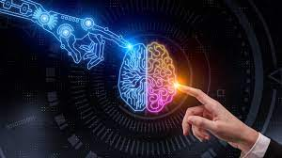
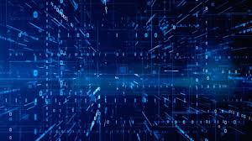
AI and ds project
TEAM MEMBERS:​
S.J SUMANTH(2010030377)​
K. SREEVARUN(200030451)​
E. PAVAN SAI(2010030538)​
E. SHIVA GOUD(2010030542)​

Slide 2
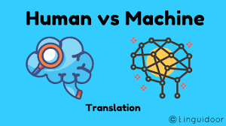
INTRODUCTION
And
Problem context
Machine translation : Machine Translation has been
defined as the process that utilizes computer software to
translate text from one natural language(such as English)
to another (such as Arabic).
Natural language processing (NLP) is the ability of a
computer program to understand human language as it is
spoken and written- referred to as natural language. It is
a component of artificial intelligence
A translator must interpret and analyze all of the elements in the text and know how each word may influence another. This requires extensive expertise in grammar, syntax (sentence structure), semantics (meanings), etc., in the source and target languages, as well as familiarity with each local region.

Slide 3

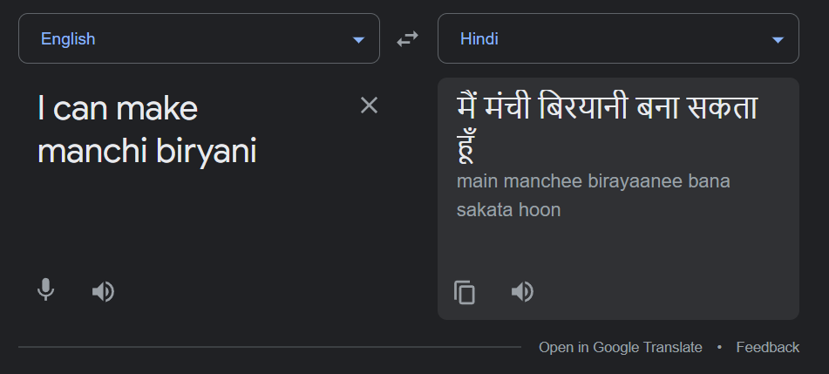








Problems in existing system
Most translators that we find on web are used to translate one language to another, then what if a person speaks a bilingual conversation…? It translates one language and leaves the unrecognized words unchanged.
This problem occurs while translating a real-time conversation as we use words of different languages when we speak.

Slide 4

CODE-MIXING Translation

Slide 5



FLOW CHART

Slide 6
Start
Give input either by audio or through text
If input==
audio

Slide 7
Convert Audio to text using pyaudio package
Else if input==
text
Detect the language using langdetect package

Slide 8
if lang.
detect()==
“te”
if lang.
detect()!=
“te”
Translate the sentence into English followed by Hindi
Translate the sentence into Telugu followed by Hindi

Slide 9
Print the translated sentence
Print “Try Again” message
Output the translated sentence in the form of audio using gTTS package
Stop

Slide 10


